Slide 1
DI 101
For producer use only. Not for use with consumers.
15082PPT DI 101(3/10)
©2010 Standard Insurance Company

Slide 2
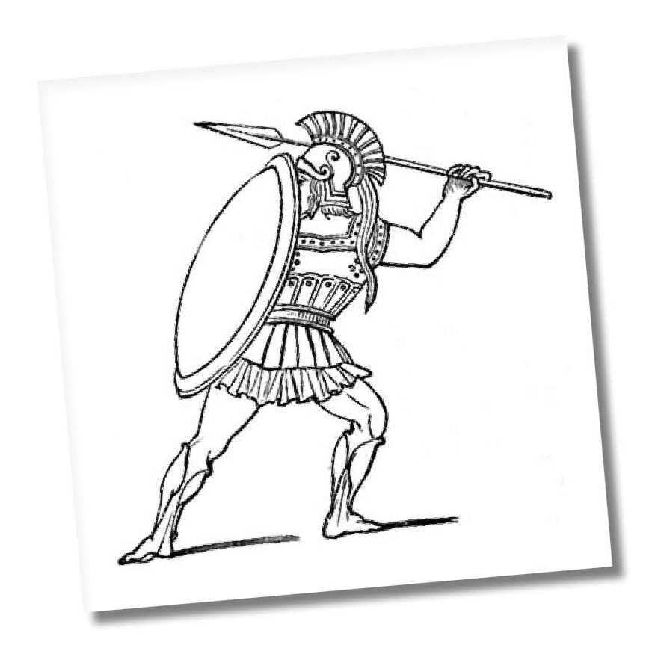
The Story of Achilles
Invincible, except for one critical vulnerability
Notes:
Achilles is a figure from Greek mythology.
When he was just a baby, his mother, sensing that he was destined to be a warrior, dipped his entire body in the mystical River Styx in order to bestow on him immortality.
With armor, weaponry along with gift of immortality, Achilles felt pretty invincible. Until one day when he was shot in the back of the foot with a poisoned arrow and ultimately died from that seemingly minor wound. As it turns out, Achilles’ mother should have dunked rather than dipped because when she dipped Achilles into the river as a baby, she had to hold onto him by his heel. As a result, his heel never touched the water and was not made immortal. Despite all of his protections, and unknown to him, Achilles had this one fatal weakness, this critical vulnerability that ultimately led to his death.
From this story, of course, is how we came to call a fatal weakness an Achilles' Heel.

Slide 3
Many of us share something with Achilles
We face battles every day to achieve, maintain and protect our lifestyle
We protect ourselves with armor
life insurance, home and auto insurance, health insurance
Notes:
So, what does the story of Achilles have to do with us?
Quite simply, many of us have a great deal in common with Achilles.
Like Achilles we face battles every day as we try to achieve, maintain and protect the lifestyle we have chosen.
And like Achilles, we protect ourselves and our assets with armor, but today we call the armor insurance. We insure our life, our home, our car, and our health.
And we arm ourselves with weapons to fight those battles, but they’re in the form of savings, investments and retirement accounts so that hopefully, someday all the battles are won and we can live in peace.
And with all of those things together in place, many of us feel just like Achilles did. We feel that we’ve taken all the right precautions, we’ve covered all of our risks, we’re protected and we are, essentially, invincible, at least financially.
But unless we are independently wealthy (and the fact that we are all here at work today suggests we’re not…), many of us are also just like Achilles in that we have a fatal weakness, a critical vulnerability.
We have our own Achilles’ Heel….our ability to earn an income.
Think about it. Everything that we do in achieving, maintaining and protecting our lifestyle is dependent on our ability to earn an income. Our home, our cars, the food we eat, the clothes we wear, the vacations we take, the plans we make for our future and our family’s future, they all assume that we’ll continue to be able to work and generate an income to pay for it all. Without that ability, even with all our protection in place, it all goes away. And if you doubt that in any way, think for a moment what would happen to you and your family if tomorrow you woke up and were unable to earn an income. Not just unemployed, mind you, but physically or mentally unable to work and earn an income. How would you pay your bills? Where would the money come from? The ability to earn an income, it’s our own Achilles’ heel.

Slide 4
Many of us share something with Achilles
We arm ourselves with weapons
savings, investments, retirement accounts
We feel protected and invincible
Yet we often overlook our most critical vulnerability
Our own Achilles’ Heel is our ability to earn an income
Notes:
So, what does the story of Achilles have to do with us?
Quite simply, many of us have a great deal in common with Achilles.
Like Achilles we face battles every day as we try to achieve, maintain and protect the lifestyle we have chosen.
And like Achilles, we protect ourselves and our assets with armor, but today we call the armor insurance. We insure our life, our home, our car, and our health.
And we arm ourselves with weapons to fight those battles, but we they’re in the form of savings, investments and retirement accounts so that hopefully, someday all the battles are won and we can live in peace.
And with all of those things together in place, many of us feel just like Achilles did. We feel that we’ve taken all the right precautions, we’ve covered all of our risks, we’re protected and we are, essentially, invincible, at least financially.
But unless we are independently wealthy (and the fact that we are all here at work today suggests we’re not…), many of us are also just like Achilles in that we have a fatal weakness, a critical vulnerability.
We have our own Achilles’ heel….our ability to earn an income.
Think about it. Everything that we do in achieving, maintaining and protecting our lifestyle is dependent on our ability to earn an income. Our home, our cars, the food we eat, the clothes we wear, the vacations we take, the plans we make for our future and our family’s future, they all assume that we’ll continue to be able to work and generate an income to pay for it all. Without that ability, even with all our protection in place, it all goes away. And if you doubt that in any way, think for a moment what would happen to you and your family if tomorrow you woke up and were unable to earn an income. Not just unemployed, mind you, but physically or mentally unable to work and earn an income. How would you pay your bills? Where would the money come from. The ability to earn an income, it’s our own Achilles’ heel.

Slide 5
How does the arrow pierce the heel?
This is partial list of disability insurance claims paid by The Standard.
Notes:
How does the arrow pierce the heel? Here is a partial list of actual claims by diagnosis, paid by The Standard.
As you can see a disabling event is non-discriminatory. There are various causes at various ages and various occupations.
One thing all of all of these individuals have in common is that they protected their Achilles' Heel by purchasing individual disability income insurance.

Slide 6
Is my Achilles’ Heel protected?
Savings and Retirement
61% of Americans say they are living paycheck to paycheck.*
Workers’ compensation
For each on the job injury, there are about three off-the-job injuries.**
*CareerBuilder Survey, September 2009.
** National Safety Council, Frequently Asked Questions.
Notes:
Clearly the risk of being disabled and unable to earn an income is, for most of us, our Achilles, Heel. So what do we do about it? How do we protect our Achilles’ Heel? Many people think they are already adequately protected.
Savings and retirement funds –
61% of Americans say they are living paycheck to paycheck. If that is the case, how many Americans are likely to have any meaningful retirement savings that they could access if they are unexpectedly disabled?
Workers’ compensation insurance –
It’s there to protect us in the event of an injury, right?
However, Workers’ Compensation only comes into play for injuries related to work.
According to the National Safety Council, 75 million days of production time were lost due to workplace injuries. However, a whopping 225 million days of production time was lost due to off-the-job incidents. (Verified Source on Feb 2010: National Safety Council at http://www.nsc.org/news_resources/Resources/res_stats_services/Pages/FrequentlyAskedQuestions.aspx#question3)
So clearly WC does not provide adequate protection for our Achilles’ Heel.

Slide 7
Is my Achilles’ Heel protected?
Social Security
The SSA is so clogged with disability claims, that some people wait for years.*
The average monthly benefit paid for to those who were approved by the SSDI in 2008 was $1,063.10**
*N.Y. Times, April 12, 2009.
**Social Security Administration, Annual Statistical Supplement, 2009.
Notes:
Social Security – According to the New York Times, the Social Security system is so clogged with disputed disability claims that some people wait years for hearings. (Source NY TIMES April 12, 2009) at http://www.nytimes.com/2009/04/13/us/13benefits.html)
Long Term Disability (LTD) through your employer – that’s an insurance product that pays you a percentage of your monthly income if you are disabled and unable to work. It’s a great thing to have, if your employer offers it, but it has some limitations as well. Usually limited to 60% replacement of income to a monthly max ($5k, $10k). Benefit may be taxable if employer pays the premium. May exclude commissions and bonus income. But this may be the best solution so far.
But there is one other solution out there.

Slide 8
Is my Achilles’ Heel protected?
Long Term Disability Insurance (LTD)
Typically limited to 60% income replacement to a monthly dollar maximum
Benefit may be taxable
May exclude commissions and bonus income
Notes:
Long Term Disability (LTD) through your employer – that’s an insurance product that pays you a percentage of your monthly income if you are disabled and unable to work. It’s a great thing to have, if your employer offers it, but it has some limitations as well. Typically limited to 60% replacement of income to a monthly max ($5k, $10k). Benefit may be taxable if employer pays the premium. May exclude commissions and bonus income. But this may be the best solution so far.
But there is one other solution out there.

Slide 9
How does IDI work?
Waiting period
Monthly benefit amount
Benefit period
Definitions
Exclusions
Underwriting process
Notes:
9
How does IDI work?
The key to understanding disability insurance is simple.
How soon do the benefits start?
How much is paid?
How long are benefits paid?
What is a disability? How is it defined?
What is not covered as a disabling event?
How does your customer get started and qualify for this type of insurance?

Slide 10
Summary
For most of us, our lifestyle depends on our ability to earn an income
Even with all of our armor, we are vulnerable
Our ability to earn an income is our Achilles’ Heel
IDI insurance protects our Achilles’ Heel
Notes:
For most of us, our lifestyle depends on our ability to earn an income
Even with all of our armor, we are vulnerable
Our ability to earn an income is our Achilles’ heel
IDI insurance protects our Achilles’ heel

Slide 11
For costs and details of coverage, including exclusions, reductions or limitations and the terms under which a policy may be continued in force, contact your insurance representative or Standard Insurance Company at 1100 Sixth Avenue, Portland, OR 97204, 800.247.6888.
Notes:
I look forward to partnering with you.

